Slide 1

Industrial gas leakage monitoring system
JNTUH College of Engineering Manthani
Centenary Colony, Pannur(V), Ramagiri(M), Peddapally(D), Telangana-505212.
Department of computer science
Team Members
N.Prathul Sai(16VD1A0502)
B.Akhila(16VD1A0502)
D.Sai teja(16VD1A0538)
S.Navaneetha(16VD1A0519)
Under the guidance of
Mr.Y.Satyam
Asst.Prof(c)

Slide 2
Topics
Problem Statement
Existing Solution
Demerits
Proposed Solution
Design
Conclusion

Slide 3
Abstract
Detection of poisonous gases in industries using cheap and reliable IoT sensors.
Preventing human, materialistic losses.

Slide 4
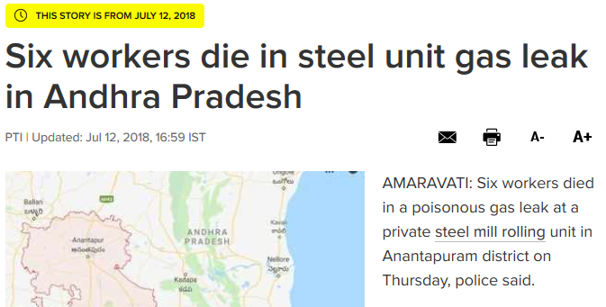
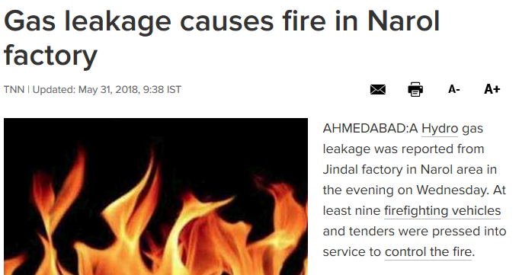
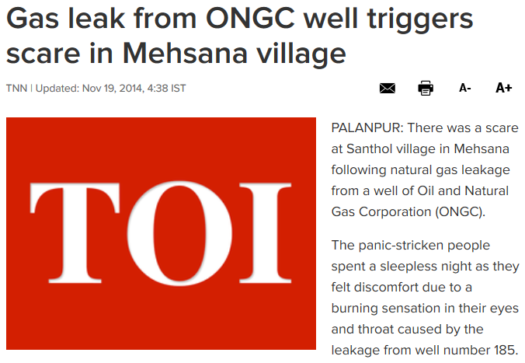
Literature survey

Slide 5
Problem Statement
Gas leakage in the industrial area causes many health issues. Every year there has been recorded no of deaths causing harm to humans as well as animals and birds.

Slide 6
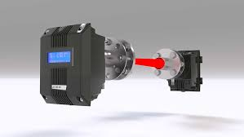
Existing Solution
Gas detection with laser
Robotic insects

Slide 7
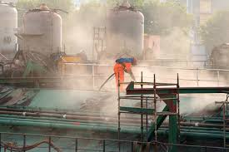
Demerits
When heavy dust , steam or fog blocks the laser beam , the system will not able to take measurements.
This method is very costly so it is always ignored by small scale industries.

Slide 8
Proposed Solution
A monitoring system for gas leakage detection needs to be developed with the combustible gas sensor (MQ9) was used to detect the presence of methane (CH4) and carbon monoxide gas (CO).

Slide 9
Components
Arduino Uno board
MQ9 sensor
Bread board
Alarm
Jumper wires

Slide 10
Languages used
C
Php
Html
Css

Slide 11
Modules
Hardware implementation
User interface

Slide 12
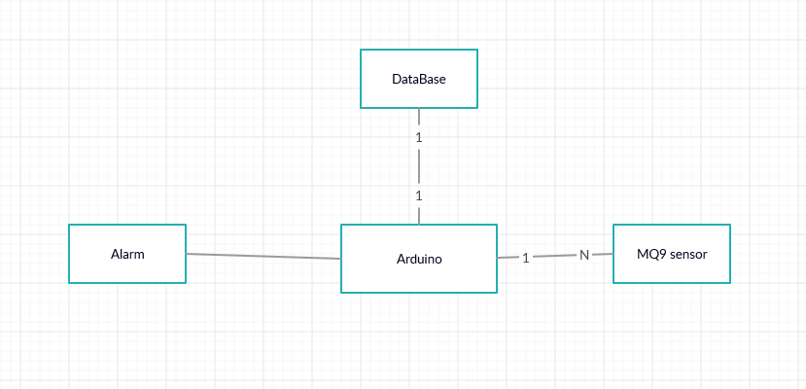
Hardware implementation

Slide 13
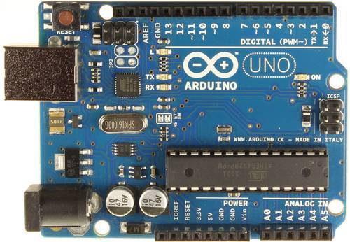
Arduino
Arduino is an open-source platform used for building electronics projects.
It consists of both a physical programmable circuit board and a piece of software, or IDE that runs on your computer, used to write and upload computer code to the physical board.

Slide 14

MQ-9 Sensor
It is a device that detects the one or more types of gas in the environment.
This sensor measures the concentration of gas.

Slide 15
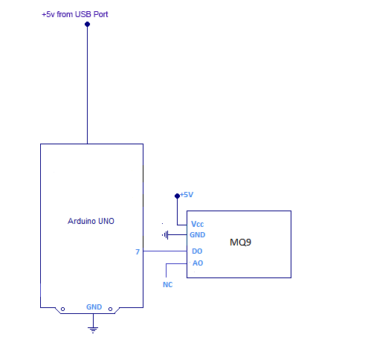
Circuit diagram

Slide 16
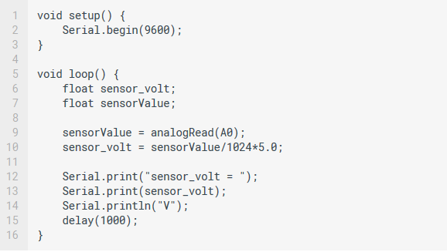
Code

Slide 17
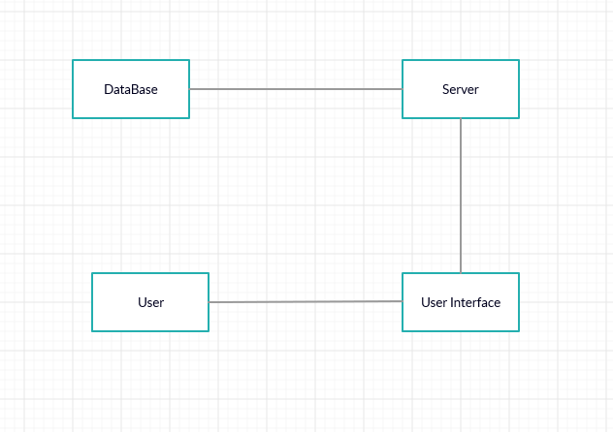
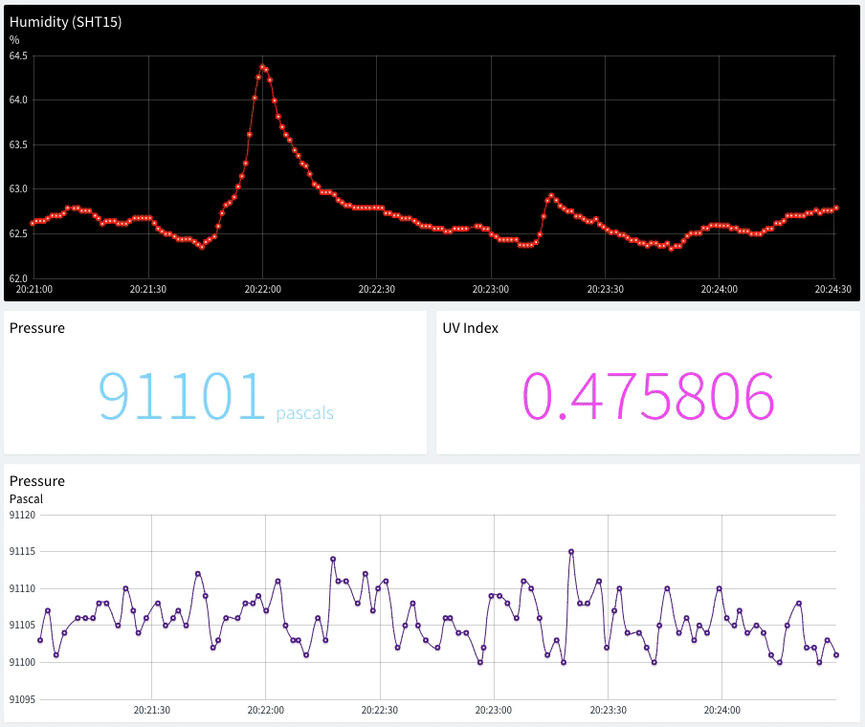
User Interface

Slide 18
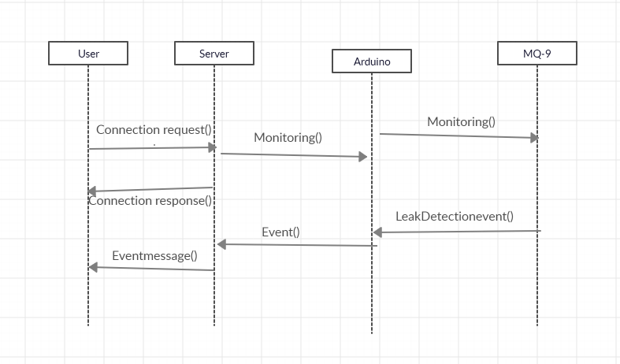
Sequence Diagram

Slide 19
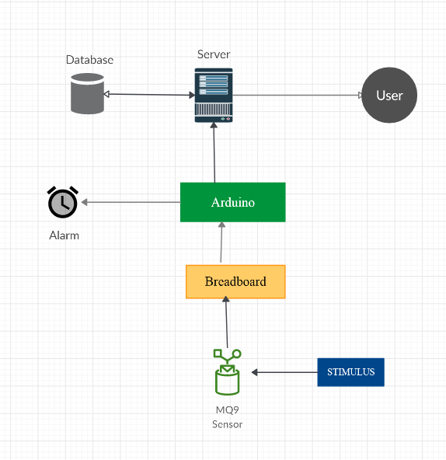
Data flow diagram

Slide 20
Conclusion
Gas leakage leads to severe accidents resulting in material losses and human injuries.
Hence, leakage detection is essential to prevent accidents and to save human lives.
This is an cost efficient way to detect harmful gases. and this device is portable so can be used in Industries,home,car.

Slide 21

Any queries ?

Slide 22
Thank you !

Slide 23
References
Images referenced from google images
https://en.wikipedia.org/wiki/List_of_industrial_disasters
http://www.indiaenvironmentportal.org.in/category/2543/thesaurus/gas-leakages/?page=3

